Slide 1


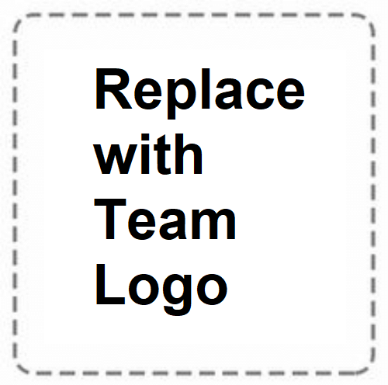

TEAM NAME:
MERAKI

Slide 2
Problem Statement
FINANCE PRODUCT RECOMMENDATION BASED ON
CUSTOMER PURCHASING POWER

Slide 3
Describe your solution
Customer profile data would be fed to a forecasting model, which will recommend a product, and the result will be displayed to the user.
Technology Stack used
Prediction/Forecasting Model
Dataset/Database

Slide 4
Use Cases & Business Value of the solution
With this system the users can get much relevant recommendation based on their requirement and other historical data.
The vendors can approach the right audience for their respective product.
The advertising companies can advertise the relevant people.

Slide 5
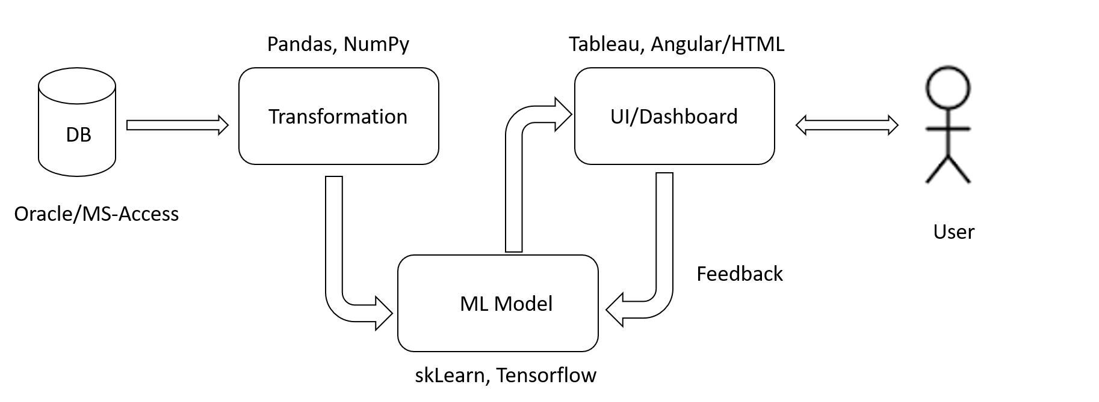
Architecture

Slide 6
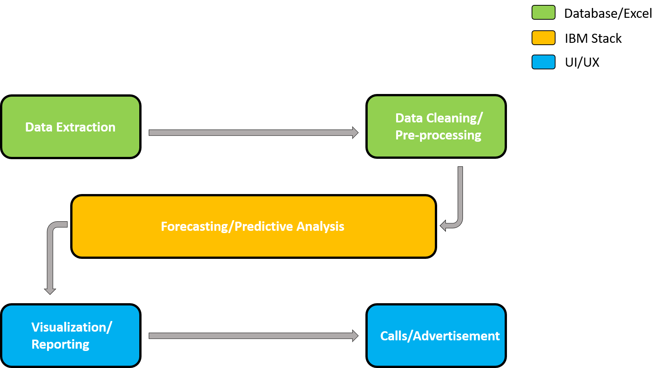
Flow Chart

Slide 7
What was accomplished
We were able to produce and train 3 models for this use case.
Extreme Gradient Boosting
Random Forest Classification
Logistic Regression
Along with considerable contribution from our IBM mentor, Srikanth Manne, we were able to build an SPSS model.

Slide 8
Challenges & Learnings
Challenges:
Selecting the appropriate Data Sets
Integrating the components
Deploying the model
Learnings:
Various data pre-processing cleaning approaches
Got a depth about the prediction models
Experience of handling data sets in huge volumes

